Slide 1

FY 2022 LOCAL GOVERNMENT SUPPORT FUND COMPONENTS
DEPARTMENT OF BUDGET AND MANAGEMENT
JOHN ARIES S. MACASPAC
Local Government and Regional Coordination Bureau
Department of Budget and Management

Slide 2
FY 2022 LOCAL GOVERNMENT SUPPORT FUND
Financial Assistance to Local Government Units | P 5,583,396,000
Support for Capital Outlays and Social Programs | 5,007,600,000
Conditional Matching Grant to Provinces for Road and Bridge Rehabilitation, Upgrading and Improvement | 500,000,000
Support to the Barangay Development Program of the National Task Force to End Local Communist Armed Conflict | 5,624,000,000
Growth Equity Fund | 1,250,000,000
TOTAL | P 17,964,996,000

Slide 3
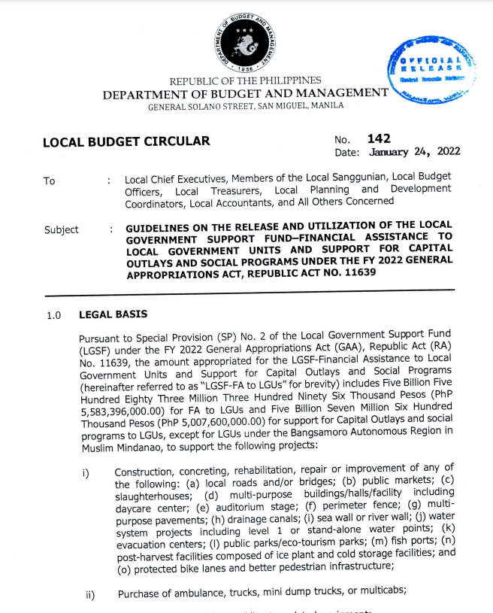
LOCAL BUDGET CIRCULAR NO. 142 DATED JANUARY 24, 2022
GUIDELINES ON THE RELEASE AND UTILIZATION OF THE LGSF–FA to LGUs AND SUPPORT FOR CAPITAL OUTLAYS AND SOCIAL PROGRAMS UNDER THE FY 2022 GAA, RA NO. 11639

Slide 4
APPROPRIATION
LGSF-Financial Assistance to Local Government Units
PhP 5,583,396,000
except for LGUs under the Bangsamoro Autonomous Region in Muslim Mindanao
Support for Capital Outlays and Social Programs
PhP 5,007,600,000
except for LGUs under the Bangsamoro Autonomous Region in Muslim Mindanao

Slide 5
ELIGIBLE PROGRAMS AND PROJECTS
Construction, concreting, rehabilitation, repair or improvement of any of the following:
local roads and/or bridges;
public markets;
slaughterhouses;
multi-purpose buildings/halls/facility including daycare center;
auditorium stage;
perimeter fence;
multi-purpose pavements;
drainage canals;

Slide 6
ELIGIBLE PROGRAMS AND PROJECTS
Construction, concreting, rehabilitation, repair or improvement of any of the following:
sea wall/river wall;
water system projects including level 1 or stand-alone water points;
evacuation centers;
public parks/eco-tourism parks;
fish ports;
post-harvest facilities composed of ice plant and cold storage facilities; and
protected bike lanes and better pedestrian infrastructure.

Slide 7
ELIGIBLE PROGRAMS AND PROJECTS
Purchase of ambulance, trucks, mini dump trucks, multi-purpose vehicles, or multicabs;
Purchase of medical/rescue/disaster-related equipment;
Street lighting or barangay electrification;
Purchase and installation of Closed-Circuit Television Surveillance System; and
Assistance to indigent individuals or families in any of the following forms: (a) medical; (b) burial; (c) transportation; (d) food assistance; (e) cash for work; and (f) educational assistance.

Slide 8
GUIDELINES IN THE RELEASE OF FY 2022 LGSF-FA TO LGUs
LGU |  | DBM Central Office |  | BTr
Submit request and corresponding documentary requirements to the DBM Central Office

Slide 9
DOCUMENTARY REQUIREMENTS
Special Budget Requests/Letter of Intent, signed by the LCE of the LGU
For purchase of motor vehicles:
(i) Project Profile for Motor Vehicles; and
(ii) Inventory of Motor Vehicles
Report on Fund Utilization for any previous releases funded under the FY 2016 to FY 2021 LGSF-FA to LGUs

Slide 10
GUIDELINES IN THE RELEASE OF FY 2022 LGSF-FA TO LGUs
LGU |  | DBM Central Office |  | BTr
Submit request and corresponding documentary requirements to the DBM Central Office |  | Check compliance with the documentary requirements submitted by the LGUs and return the same immediately in the event that the documentations required are incomplete
 |  | Conduct evaluation of the fully compliant SBRs and render appropriate action thereon

Slide 11
INDICATIVE CEILING
Level of LGU | Maximum Amount per LGU
Barangay | 5,000,000
Municipality | 10,000,000
City | 20,000,000
Province | 30,000,000

Slide 12
GUIDELINES IN THE RELEASE OF FY 2022 LGSF-FA TO LGUs
LGU |  | DBM Central Office |  | BTr
Submit request and corresponding documentary requirements to the DBM Central Office |  | Check compliance with the documentary requirements submitted by the LGUs and return the same immediately in the event that the documentations required are incomplete
 |  | Conduct evaluation of the fully compliant SBRs and render appropriate action thereon
 |  | Prepare the SARO and NCA |  | Issues ADA to AGSBs and Issues NADAI to LGUs
 |  | Send Confirmation Letters to LGUs concerned to provide them details of the funds released immediately

Slide 13
DEADLINE
June 30, 2022
in order to ensure that funds are released within the Fiscal Year

Slide 14
LIMITATIONS ON THE USE OF THE LGSF-FA TO LGUs
The LGSF-FA to LGUs shall only be used:
For the purpose the program and/or project, including the location thereof, for which the fund was released; and
For the purchase of motor vehicles with specifications, costs, deployment, and/or purpose as specified in the APMV in the form of Confirmation Letter issued by the DBM to the LGU.
The LGSF-FA to LGUs shall not be used for:
Projects already fully covered by other sources of funds; and
Payment of Personal Services expenditures.

Slide 15
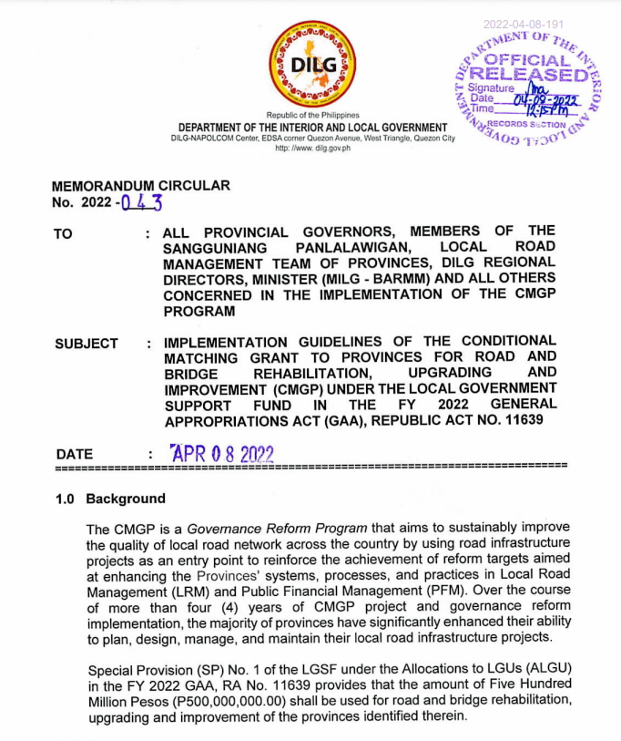
DILG MEMORANDUM CIRCULAR
NO. 2022-043 DATED APRIL 8, 2022
IMPLEMENTATION GUIDELINES OF THE CONDITIONAL MATCHING GRANT TO PROVINCES FOR ROAD AND BRIDGE REHABILITATION, UPGRADING AND IMPROVEMENT UNDER THE LGSF IN THE FY 2022 GAA, RA NO. 11639

Slide 16
APPROPRIATION
PhP 500,000,000
covers seventeen (17) provinces identified in FY 2022 GAA, namely: Ifugao, Quirino, Aurora, Bulacan, Zambales, Cavite, Rizal, Southern Leyte, Camiguin, Lanao del Norte, Misamis Occidental,
Davao del Norte, Davao del Sur, Agusan del Norte, Surigao del Sur, Sulu, and Tawi-Tawi

Slide 17
DOCUMENTARY REQUIREMENTS
Result of 2021 Local Road Management Performance Assessment
01
03
Notarized Omnibus Sworn Statement
Latest DBM-validated Public Financial Management Improvement Plan
Detailed Engineering Design compliant with the DPWH standards
02
04

Slide 18
DEADLINE OF SUBMISSION
June 30, 2022

Slide 19
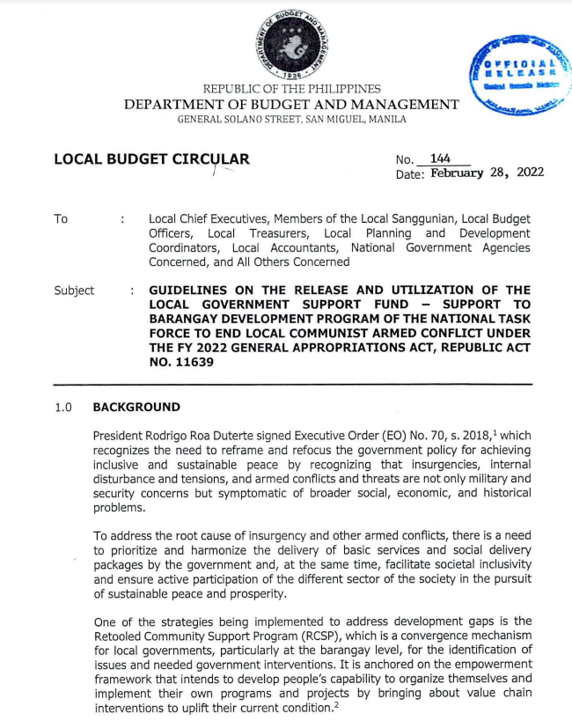
LOCAL BUDGET CIRCULAR NO. 144 DATED FEBRUARY 28, 2022
GUIDELINES ON THE RELEASE AND UTILIZATION OF THE LGSF- SUPPORT TO BARANGAY DEVELOPMENT PROGRAM OF THE NATIONAL TASK FORCE TO END LOCAL COMMUNIST ARMED CONFLICT UNDER THE
FY 2022 GAA, RA NO. 11639

Slide 20
APPROPRIATION
PhP 5,624,000,000
implementation of various support programs of the NTA-ELCAC for the 1,406 cleared barangays

Slide 21
ELIGIBLE PROGRAMS AND PROJECTS
Each cleared barangay shall be allocated with an amount not exceeding PhP 20,000,000 to be used for the following projects:
farm-to-market road;
school building;
water and sanitation system;
health stations; and
electrification.

Slide 22
DOCUMENTARY REQUIREMENTS
Request letter signed by the Punong Barangay;
In case the request covers 2 or more projects, the order or hierarchy of priorities of the barangay shall be provided in the request letter; and
Contact details signed by the Punong Barangay.

Slide 23
GUIDELINES IN THE RELEASE OF FY 2022 LGSF-SBDP
Cleared Barangays
P/C/M Governments
RTF-ELCAC
Cleared Barangays to submit documentary requirements to the province/city/municipal (P/C/M) government
RTF-ELCAC shall evaluate the proposed projects, and endorse eligible and compliant requests to NTF-ELCAC
P/C/M shall endorse the proposed projects of compliant barangays to RTF-ELCAC
Bureau of Treasury
DBM Central Office
NTF-ELCAC
BTr shall issue ADA to to the AGSBs and NADAI to LGUs
DBM CO shall prepare the SARO and NCA
NTF-ELCAC shall consolidate and endorse compliant requests to DBM CO

Slide 24
GUIDELINES ON THE RELEASE AND UTILIZATION OF THE LOCAL GOVERNMENT SUPPORT FUND – GROWTH EQUITY FUND UNDER THE FY 2022 GENERAL APPROPRIATIONS ACT, RA NO. 11639

Slide 25

ESTABLISHMENT OF GROWTH EQUITY FUND
APPROPRIATION:
P1.25 B
A Growth Equity Fund shall be established starting FY 2022 to address problem of marginalization, unequal development, and high poverty incidence across different LGUs.

Slide 26




ELIGIBILITY CRITERIA
Income Bracket
Deflated the FYs 2017-2020 income to the FYs 2004-2007 income of the LGUs
Poverty Incidence
2018 Full Year Official Poverty Statistics and 2018 Municipal and City Level Poverty Estimates of the PSA
Per capita FY 2022 NTA
ratio of the National Tax Allotment for the FY 2022 and the 2020 POPCEN of the PSA

Slide 27
ALLOCATION CRITERIA
50%
50%
Poverty incidence from the 2018 Family Income and Expenditure Survey (FIES) of the PSA
per capita FY 2022 NTA based on the 2020 Census of Population of the PSA
*The LGUs in the BARMM shall not be included in the allocation of the FY 2022 LGSF-GEF.

Slide 28
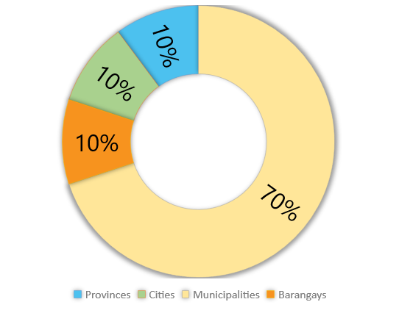
ALLOCATION CRITERIA
LEVEL OF LGU | % ALLOCATION | ALLOCATION (PhP)
Provinces | 10% | 125 Million
Cities | 10% | 125 Million
Municipalities | 70% | 875 Million
GIDA Barangays | 10% | 125 Million
Total | 100% | PhP 1.25 B
*The LGUs in the BARMM shall not be included in the allocation of the FY 2022 LGSF-GEF.

Slide 29
BENEFICIARY LGUs
LGU Level | Income Bracket | No. of LGUs | Allocation (PhP)
 |  |  | Min | Max | Average
Provinces | Bracket 4 | 3 | 11,185,920 | 58,000,370 | 41,666,667
Cities | Bracket 4 | 8 | 9,400,220 | 25,147,200 | 15,625,000
Municipalities | Bracket 4 to 5 | 150 | 2,696,340 | 9,086,600 | 5,833,333
GIDA Barangays | From Municipalities belonging to Bracket 4 to 5 | 259 | 332,650 | 584,720 | 482,625

Slide 30
RELEASE OF THE ALLOCATIONS
The SARO shall be released by the DBM to the BTr, while the corresponding NCAs shall be released to the AGSBs of the beneficiary LGUs.
01
FY 2022 LGSF-GEF - released to the beneficiary provinces, cities, municipalities, and barangays.
03
Beneficiary LGUs are not required to submit any documentary requirement prior to the release of the fund
Upon receipt of the Advice of NCA Issued from the DBM, the BTr shall release the corresponding ADAs to the AGSBs of the beneficiary LGUs.
02
04

Slide 31
UTILIZATION OF THE ALLOCATIONS
The FY 2022 LGSF-GEF shall be exclusively used by the beneficiary LGUs to gradually enable the full and efficient implementation of the devolved functions and services.
03
The LGUs that have not yet prepared and submitted their respective LGU DTPs as of December 31, 2021 shall not be qualified as beneficiary of FY 2022 LGSF-GEF.
01
The programs and projects to be funded from the allocation of the beneficiary LGUs shall be included in their respective duly approved Local Development Investment Programs and Annual Investment Programs.
02
The programs and projects to be funded from the allocation of beneficiary LGUs shall be those that are included in their respective Devolution Transition Plans (DTPs).
04

Slide 32
UTILIZATION OF THE ALLOCATIONS
In the identification of the programs and projects to be implemented, the beneficiary LGUs shall conduct public consultations, through the Civil Society Organizations, to determine the appropriate programs and projects that are deemed most beneficial to their constituents.
In case the beneficiary LGU decides to use its allocation for infrastructure projects, said LGU shall observe and comply with the requirements on the implementation of infrastructure projects.
05
07
Disbursement and utilization of funds by the beneficiary LGUs shall be subject to pertinent provisions of RA No. 9184 and its IRR, and any relevant policies issued by the GPPB, as well as, the applicable budgeting, accounting, and auditing rules and regulations.
06
In the implementation of programs and projects funded from the FY 2022 LGSF-GEF, the beneficiary LGUs shall seek technical assistance from the NGAs concerned, as may be necessary.
08

Slide 33
LIMITATIONS ON THE USE OF THE FY 2022 LGSF-GEF
The FY 2022 LGSF-GEF shall not be used for the following expenditure items:
Payment of Personal Services expenditures;
Administrative expenses;
Traveling expenses, whether domestic or foreign;
Registration fees and other expenses related to the conduct of and participation to trainings, seminars, conferences or conventions;
Purchase, maintenance or repair of administrative office’ furniture, fixtures, equipment or appliances;
Purchase, maintenance or repair of motor vehicles used for administrative purposes; and
Other PPAs and expenses that are not related to the implementation of devolved functions and services of LGUs.

Slide 34
MONITORING AND EVALUATION
DILG - monitoring and evaluation (M&E) of actual project implementation of LGUs
DBM - provide the DILG with a list of releases for M&E purposes
Beneficiary LGUs - comply with the guidelines that may be issued by the DILG for M&E of actual implementation of projects

Slide 35
VALIDITY OF FY 2022 LGSF COMPONENTS
December 31, 2023

Slide 36
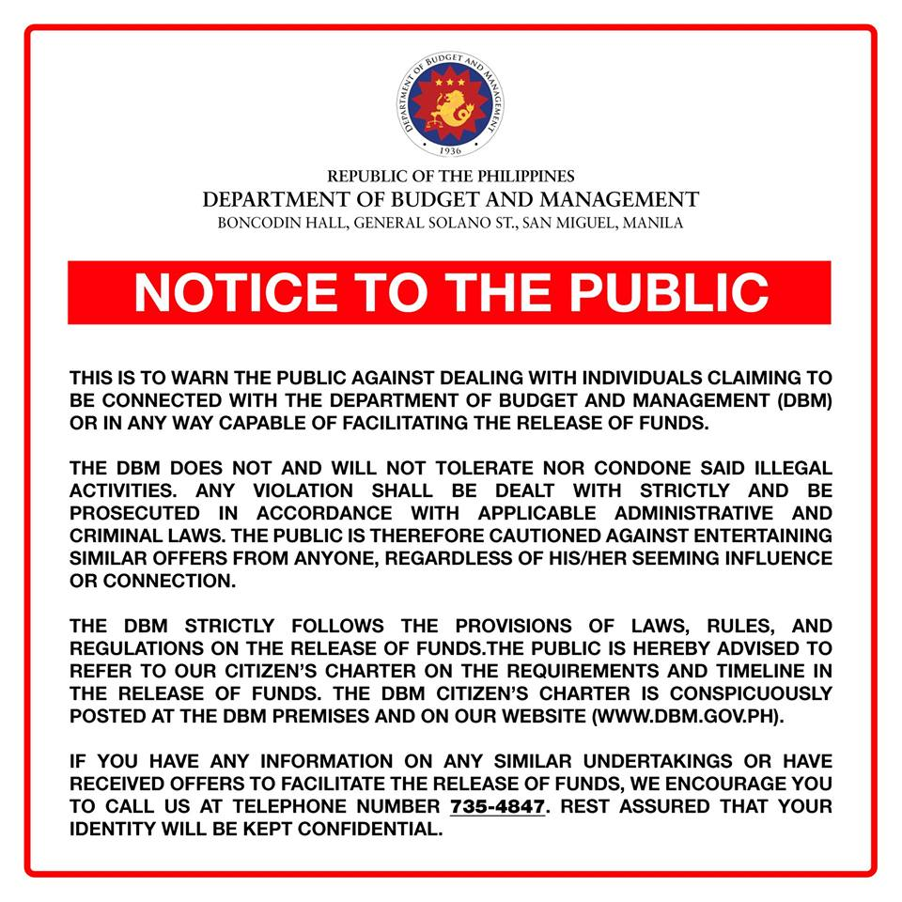

Slide 37
Thank you!
For more information:
Department of Budget and Management
General Solano Street, San Miguel, Malacañang, Manila
Trunkline: (02) 8657-3300 local 2345
Website: www.dbm.gov.ph

